Slide 1

ARYA TEJA | GROUP-1
PREDICTIVE MAINTENANCE AND PROCESS INTELLIGENCE
MACHINE LEARNING-BASED MODEL EVALUATION AND COMPARISON ANALYSIS

Slide 2


PREDICTIVE MAINTENANCE
PROBLEM STATEMENT
In predictive maintenance systems, selecting the most reliable and accurate machine learning model is critical for effective decision-making. Model evaluation ensures that predictions are trustworthy and actionable. Without proper evaluation, organizations risk deploying models with poor performance, leading to unexpected equipment failures or unnecessary maintenance costs. A well-evaluated model directly impacts system reliability, operational efficiency, and overall business outcomes by enabling accurate predictions of equipment failures before they occur.
WWW.REALLYGREATSITE.COM

Slide 3


ML MODEL EVALUATION
TECHNOLOGY STACK
Matplotlib & Seaborn:
Python & Scikit-learn
Core framework for machine learning model development, training, and evaluation with comprehensive algorithm support.
Statistical visualization libraries for creating insightful charts and performance graphs.
Pandas & Data Processing
ML Algorithms & Metrics:
Efficient data manipulation, cleaning, and preparation for model training and analysis pipelines.
Advanced algorithms with performance evaluation metrics for comprehensive model comparison.
WWW.PREDICTIVE-MAINTENANCE.AI

Slide 4

PREDICTIVE MAINTENANCE
Compare Models:
Compare multiple ML models side by side.
Standard Metrics:
Evaluate using industry-standard metrics.
MODEL EVALUATION AND COMPARISON ANALYSIS
Identify model capabilities and limitations.
Strengths & Weaknesses:
Performance Reports:
Generate detailed evaluation reports.
MACHINE LEARNING-BASED MODEL EVALUATION

Slide 5
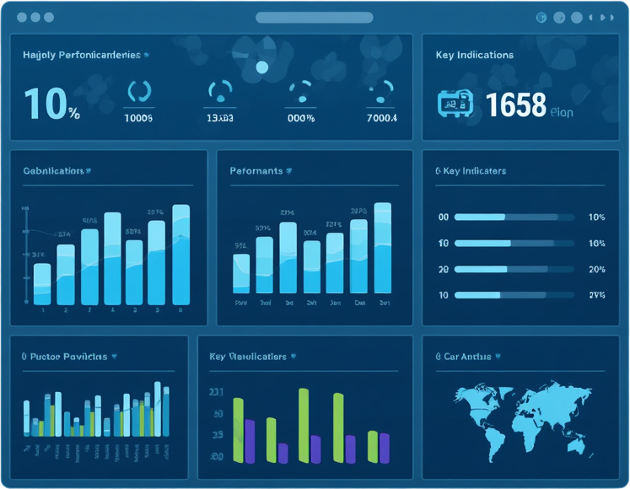
PREDICTIVE MAINTENANCE
EVALUATION METRICS
01.
Accuracy & Precision
03.
Training Time
02.
Recall & F1-Score
04.
Confusion Matrix
These key metrics enable comprehensive model evaluation, measuring correctness, relevance, efficiency, and detailed error analysis for informed model selection.
ARYA TEJA | GROUP-1

Slide 6

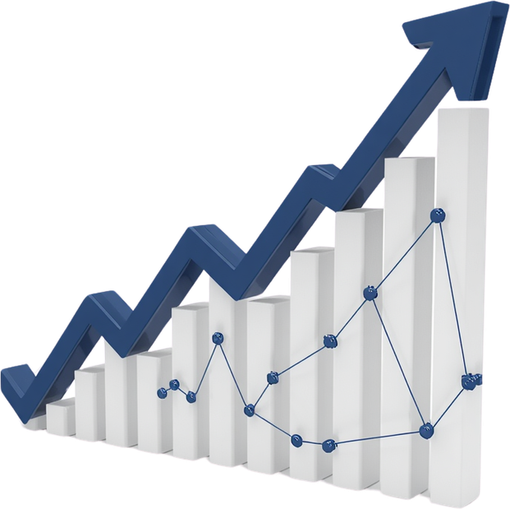

PREDICTIVE MAINTENANCE
COMPARISON & VISUALIZATION
The module generates comprehensive comparative tables displaying metric values for each evaluated model. Bar charts and line graphs illustrate performance metrics across models, enabling quick visual comparison. Heatmaps and scatter plots reveal patterns in accuracy, precision, and recall. These visualizations facilitate rapid identification of model strengths and weaknesses, supporting data-driven decisions for model selection in predictive maintenance applications.
WWW.REALLYGREATSITE.COM

Slide 7

PREDICTIVE MAINTENANCE
BEST MODEL SELECTION
Our module automates the best model selection process through comprehensive evaluation metrics. The workflow follows a clear path: Input Models → Performance Evaluation → Visualization → Best Model Selection → Final Report. Each model is assessed using accuracy, precision, recall, and F1-score to identify the optimal choice. Confusion matrices provide detailed prediction insights, revealing false positives and false negatives. The automated report generation consolidates all performance data into a complete summary, enabling stakeholders to make informed decisions about which ML model best serves their predictive maintenance needs.
GROUP-1 | ARYA TEJA

Slide 8


PREDICTIVE MAINTENANCE
CONCLUSION
Key Achievements:
✓ Successfully designed a comprehensive ML model evaluation framework
✓ Enables fair comparison among competing predictive models
✓ Supports reliable selection of efficient models for predictive maintenance
✓ Improves reliability and interpretability of machine learning results
✓ Establishes a standardized approach for ongoing model performance monitoring
ARYA TEJA | GROUP-1

Slide 9

PREDICTIVE MAINTENANCE
THANK
YOU!
BYE | PRESENTED BY ARYA TEJA (GROUP-1)

